Slide 1

Job Scheduling for Adaptive Applications in Future HPC Systems
Nishanth Nagendra
Master Thesis Presentation, TUM, July 2016

Slide 2
AGENDA
Introduction
Resource Management
Invasive Resource Management
iRM Architecture
Negotiation
Algorithms
Results

Slide 3
INTRODUCTION
What is a batch system?
  Middleware for managing supercomputing resources.
  Scheduler + Resource Manager to run parallel jobs.
Classification of Parallel jobs
  Static
  Moldable
  Malleable
  Evolving
Rigid
Invasive / Adaptive
Notes:
There are several types of parallelism that can be mentioned here but we restrict ourselves to some of them and especially those which are of interest for us concerning this topic.

Slide 4
RESOURCE MANAGEMENT
Role of a Resource manager?
  Allocate resources.
  Launch and otherwise manage jobs.
  SLURM, TORQUE, OMEGA, IBM Platform LSF
Role of a Job Scheduler?
  Queuing and Scheduling.
  Support Scheduling algorithms such as FIFO, Priority, Backfill, Gang etc.
  Support fair share scheduling, advanced reservations, preemption. Optimizations for energy, topology, throughput.
  Maui, LoadLeveler, OAR, SLURM
Notes:
OMEGA by Google: predicts the benefits of scaling up current and pending MapReduce jobs, and apportions some fraction of the unused resources across those jobs according to some policy."
SLURM: Slurm uses a best fit algorithm based on Hilbert curve scheduling or fat tree network topology in order to optimize locality of task assignments on parallel computers
Just using the term “Resource Management” to refer to both resource manager and scheduler

Slide 5
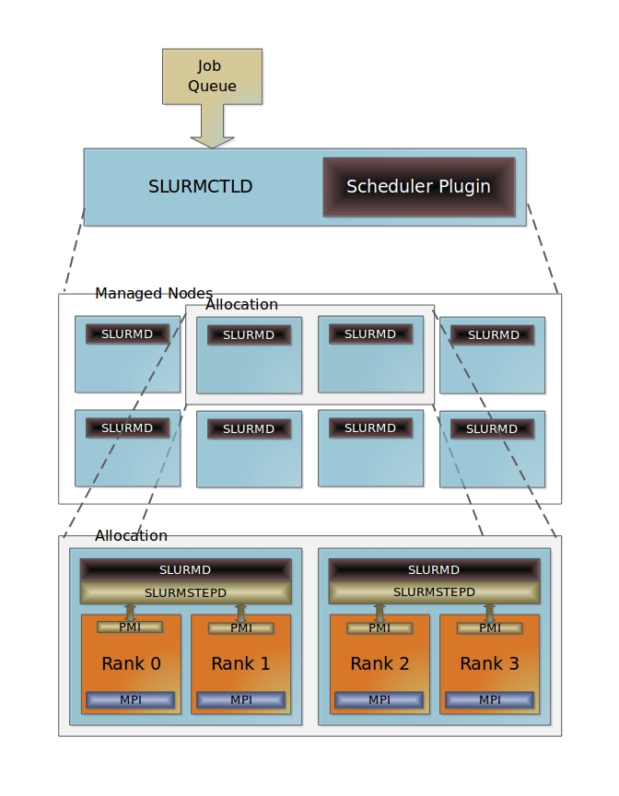
EXISTING ARCHITECTURE

Slide 6
INVASIVE RESOURCE MANAGEMENT
Existing batch systems support only static allocation of resources.
What do we need? Invasive Resource Mgmt.
How do we achieve this?
  Invasive Runtime Scheduler (alias. iRTSched)
  Invasive Batch Job Scheduler (alias. iBSched)
  A generic protocol to integrate invasive resource management into existing batch systems.
  Our choice of an existing batch system upon which we demonstrate this: SLURM!!!
INVASIC project.
Invasive Resource Mgmt.
Separation of Concerns
Separation of Concerns
Notes:
Frame rule has been used in program verification since 15 yrs.

Slide 7
ARCHITECTURE FOR INVASIVE RESOURCE MANAGEMENT (iRM)
Notes:
Jobs are now forwarded to a runtime scheduler instead of directly launching them on the provided resources.

Slide 8
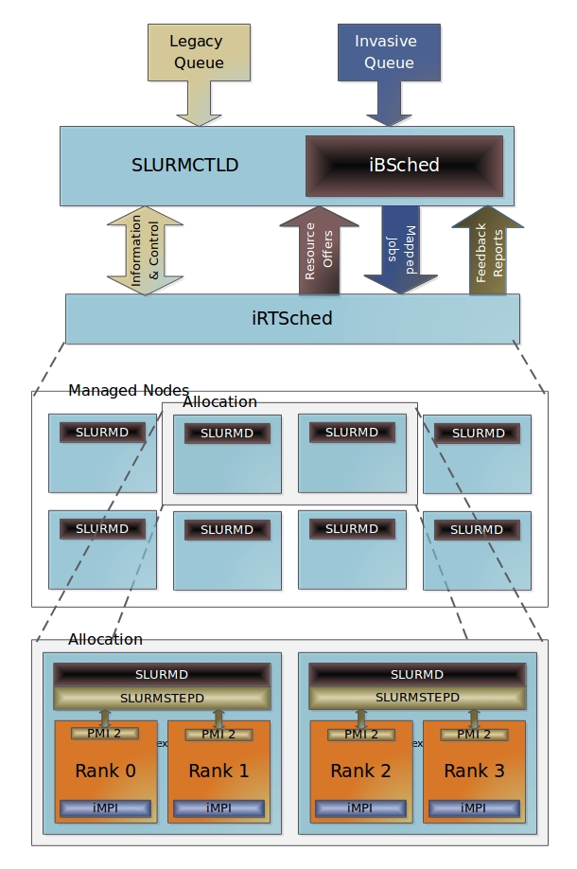
Scheduling at a coarser level of granularity: nodes.
Negotiates with the iRTSched for offers.
Event based scheduling. Resource offers influence
scheduling decisions.
Objectives: fairness, reduced job waiting times, QoS, high throughput, priorities etc.
Scheduling at a finer level of granularity: cores, sockets.
Topology based mapping.
Acts as some sort of a virtualization layer.
Resource offers could represent real or virtual resources.
Can support time sharing of resources.
Objectives: utilization, energy efficiency, high throughput.
Notes:
Resource offers influence scheduling decisions. Runtime scheduler can send offers for many events but it is left to its decision whether it wants to or not.
Traditionally schedulers run periodically, after new job submissions, terminations etc.
Traditionally, Scheduler decisions are not influenced in any manner.
Scheduling decisions are made to achieve certain metrics like high job throughput, reduced job waiting times, urgent computing, deadlines, priorities etc.
Currently, runtime scheduler is very simple without the many features presented here.
Resource utilization, Energy, Power, Execution time
Deadlines, Job throughout, Urgent computing

Slide 9
NEGOTIATION

Slide 10
Negotiation Protocol
iBSched
node count
iRTSched
Blocked waiting for an offer
Creates a new offer
RESOURCE_OFFER
Map jobs to the given offer. Best fit!!!
list of jobs
Waiting for a response.
RESOURCE_OFFER_RESP
list of jobs (reservations) + freenodes count
Rejects the mapping and sends a different offer.
Blocked waiting for an offer
RESOURCE_OFFER
RESOURCE_OFFER_RESP
Sends a return code to indicate that it rejected the offer as it could not map any job to this offer.
Creates a new offer
RESOURCE_OFFER

Slide 11
Negotiation Protocol
iBSched
iRTSched
Map jobs to the given offer. Best fit!!!
Waiting for a response.
RESOURCE_OFFER_RESP
Map: Job → offer
Negotiations continue till an agreement is reached. Negotiations will stop once a system configured limit on the possible number of attempts is exceeded.
Launches the accepted jobs in the mapping

Slide 12
Negotiation Protocol
Different Scenario
iBSched
iRTSched
Blocked waiting
for an offer
Creates a new offer
RESOURCE_OFFER
Map jobs to the
given offer.
Best fit!!!
Waiting for a
response.
RESOURCE_OFFER_RESP
Sends a return code to indicate that it rejected the offer as there are no jobs.
New job enters the invasic queue.
Idle
list of jobs
REQUEST_RESOURCE_OFFER
Blocked waiting
for an offer
Creates a new offer
RESOURCE_OFFER
Could be a positive or a negative reply here
Notes:
A list of jobs are being forwarded in the request for resource offer msg. This is done in order to avoid wasting the negotiation attempts by exchanging data which is not useful.

Slide 13
ALGORITHMS

Slide 14
Batch Scheduling Algorithm
Input: Resource Offer
Output: Job List
while not at the end of job queue do
read next queue entry
if entry.jobId in offer.reservations then
resv = reservations (entry.jobId)
update job details from the offer
if resv.node_count EQ 0 then
adjustNodeCount(entry.jobId)
else
mapped = true
end if
end if
if mapped NEQ true then
try mapping to the freenodes
if successfully mapped then
update the count of freenodes
end if
end if
create forward job record using entry
append record to List
end while
try_to_best_fit (List)
Reserved Job
(limit on the number of resv jobs that can be forwarded)
original constraints:
50 – 100
current constraints:
90 – 100
adjusted constraints:
80 - 100
Mapped Job
Notes:
Loop will also break if the freenodes count is zero.

Slide 15
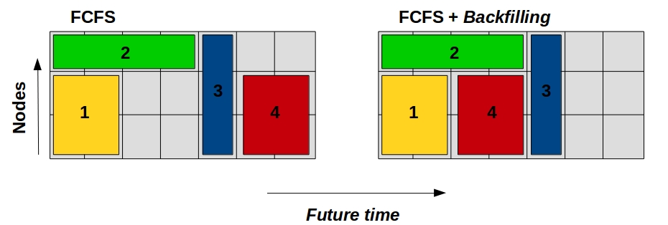
DBES
(Dependency based expand shrink algorithm)
  Backfilling
  Dependencies: 3 → (2) and 4 → (1) [ref. to second fig.]
0
t1
t2
Expand
Expand
Shrink
Shrink

Slide 16
Runtime Scheduling Algorithm
Input: Job List
Output: Resource Offer
Schedule requests and create reservations (without job start)
Update job dependencies
for each reserved job do
Prioritize malleable jobs in the order:
(1) malleable job expanded for this reserved job,
(2) malleable job expanded for no specific reserved job,
(3) malleable job expanded for other reserved jobs
Analyze if expanded malleable jobs can be shrunk
(step size) in the above order to make enough nodes
available to start the reserved job.
if enough nodes found then
Shrink the selected malleable jobs
Insert the job as an entry in Offer.Reservations
end if
end for
Reschedule requests and create reservations (without job start)
Update job dependencies
for each reserved job do
if job depends on a malleable job then
Expand the malleable job with the available nodes
end if
end for
equipartition the free nodes amongst other jobs
Decision logic
Notes:
Expand step can consider shrinking other running malleable jobs whose dependencies from batch jobs are lower in priority than the current batch job.

Slide 17
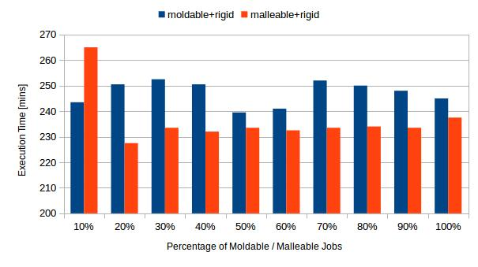
RESULTS
  Benchmark used: ESP (Effective System Performance). Modified to generate a malleable+rigid or moldable+rigid workload.

Slide 18


Slide 19
QUESTIONS ???

